Slide 1
The Asos-Paeds investigators

Slide 2
OVERVIEW
Background
Registration process
Data collection
The importance of data quality
Notes:
Content slide with line

Slide 3
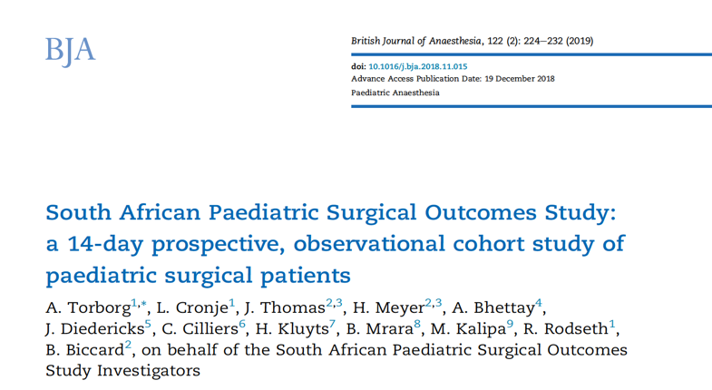
Notes:
There are few prospective studies of paediatric perioperative outcomes in Africa. The SAPSOS study describes the paediatric surgical population in South Africa, a middle-income country (MIC). The incidence and types of complications are different from high income countries (HICs), risk factors for complications are different from HICs. Postoperative mortality is higher than in HICs .
incidence of complications 9.7% (double HICs)
Mortality 1.1% (10x HIC = APRICOT study)

Slide 4
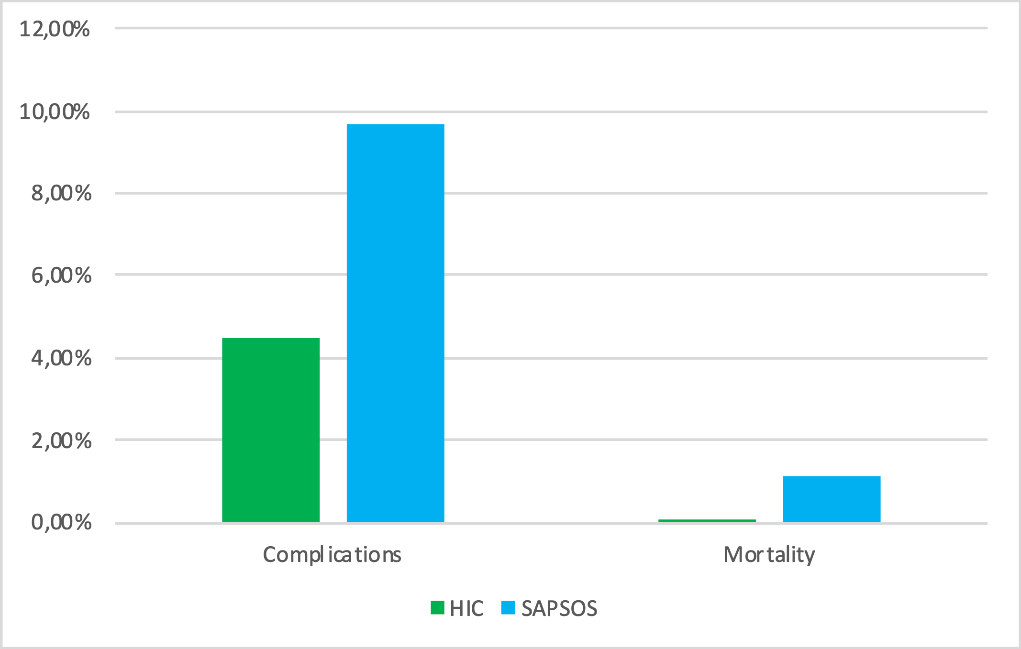
The SAPSOS Investigators British Journal of Anaesthesia 2019
Notes:
The SAPSOS study describes the paediatric surgical population in South Africa, a middle-income country (MIC). The incidence and types of complications are different from high income countries (HICs), risk factors for complications are different from HICs. Postoperative mortality is higher than in HICs .
incidence of complications 9.7% (double HICs)
Mortality 1.1% (10x HIC = APRICOT study)

Slide 5
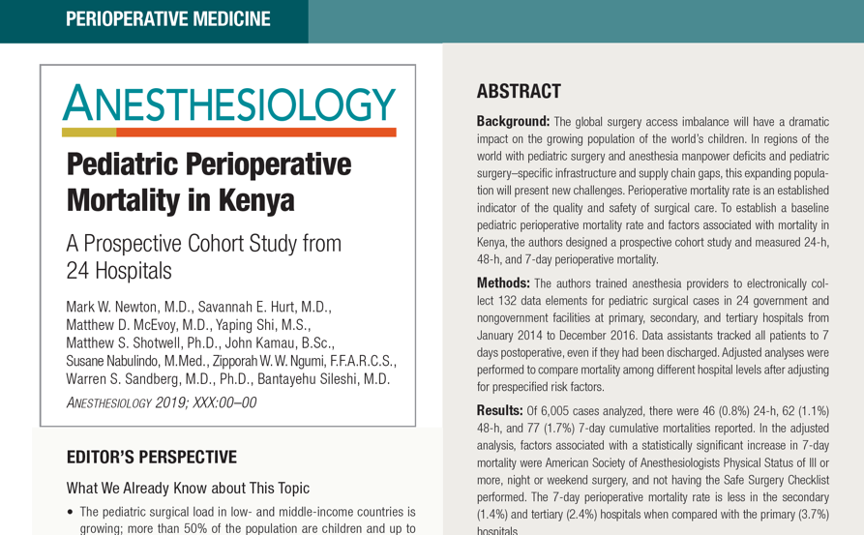
Newton et al Anesthesiology December 2019
Notes:
A prospective study of paediatric perioperative mortality in 24 Kenyan hospitals showed a 7 day postoperative mortality of 1.7%.(4)

Slide 6
The ASOS Investigators The Lancet January 2018
Notes:
We are aware of the Adult studies – ASOS and ASOS-2, both studies published in high impact journals. There is a well-established network in Africa

Slide 7
The ASOS-2 Investigators Lancet Global Health 2021

Slide 8
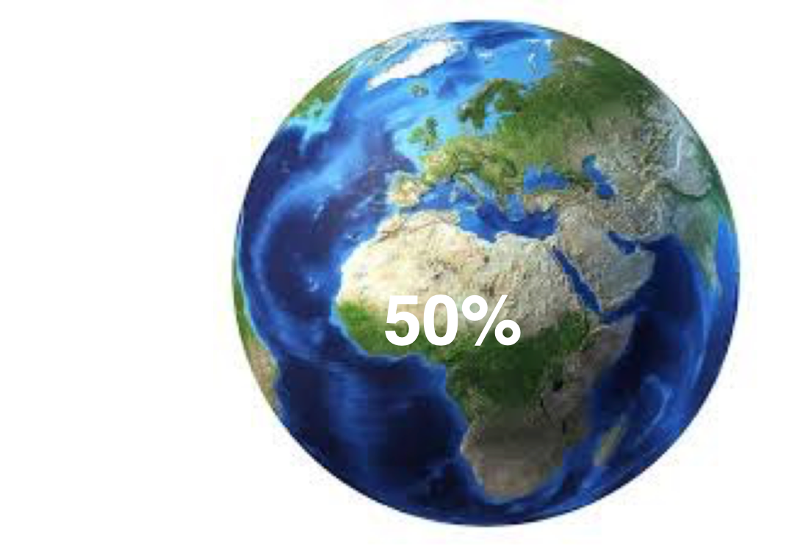
Notes:
In Africa, approximately 50% of the population are ≤19 years old. This is a significant proportion of our population. A lot of these patients require surgery.
2014 world population sheet www.prb.org

Slide 9
An African, international multi-centre fourteen-day evaluation of patient care and clinical outcomes for paediatric patients undergoing surgery

Slide 10
OBJECTIVES
Primary objective
In-hospital postoperative complications up to 30 days post-surgery
Secondary objectives
In-hospital peri-operative mortality rate up to 30 days post-surgery,
Incidence of intraoperative severe critical incidents,
To determine the association between pre-operative, intra-operative and facility factors with postoperative complications and death.
Notes:
Paediatric surgical patients <18 years in Africa

Slide 11
PROCEDURE FOR REGISTERING
The PI confirms name and contact details of national lead
SSSA team contacts the national lead and sends registration link
SSSA team sends names of investigators that have declared interest to the national leader at regular intervals
The national lead confirms hospital lead names and contact details
SSSA team forwards registration link to authorized hospital leads
SSSA team forwards registration link for investigators to hospital leads to send on to their team members

Slide 12
PROCEDURE FOR REGISTERING
REGISTER AS AN INVESTIGATOR
ON THE APON PLATFORM

Slide 13
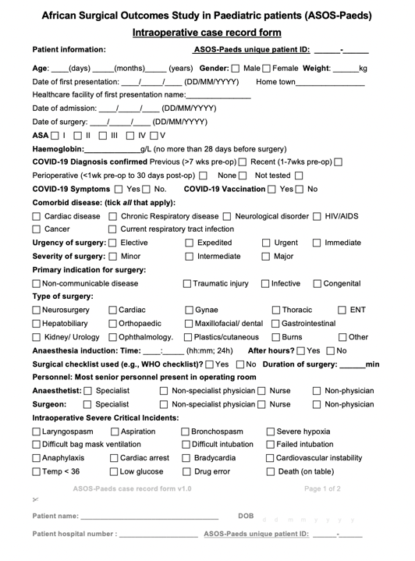
INTRA-OP CRF

Slide 14
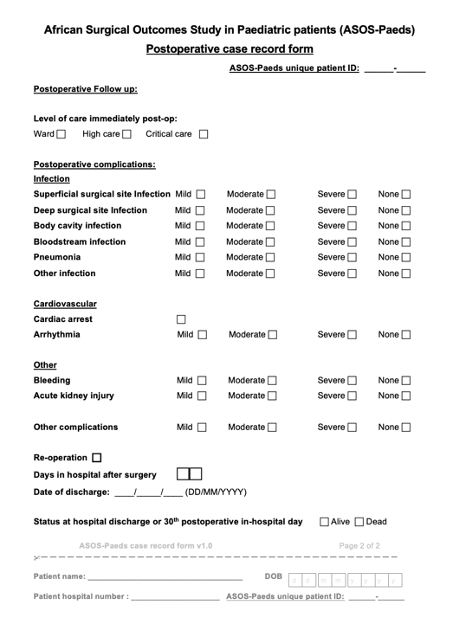
POST-OP CRF

Slide 15
THE IMPACT OF QUALITY WORK
Data quality is important
Reported in the publication:
Number of eligible patients and number recruited
How much missing data
Every eligible patient should be recruited
Reflection of the ASOS team
High impact journals accept publications of high-quality research
Notes:
The quality of the data we collect is important. We need to report on the quality of our data when we publish. We report the number of eligible patients and total no. recruited. We do this to show that the sample is representative of the patient population and what is really happening with patients. If every eligible patient is not included then the data is not generalizable to the population and it creates bias if there are missing patients. We also report how much data was missing. If there is a lot of of missing data then it indicates poor quality data.
Every eligible patient should be recruited.
The quality of our work reflects on our integrity as a group of researchers. We all understand that it is hard to do it well.
We have made our studies pragmatic with as few data points as possible in order to make sure we are only collecting the most important data. This also helps to limit errors and omissions. We are aware that we are all clinician researchers with a lot of responsibilities.
If we want to publish in high impact journals such as the Lancet, then we need to be meticulous from the start.
The journals want confirmation that the data represents what is really happening to our patients. If we miss patients then there is bias, if we miss data then it is hard to show outcomes. We need to be able to show there is no bias and that we are producing high quality data.

Slide 16
NUMBER OF ELIGIBLE PATIENTS = SCREENING LOG
All studies need to report the number of eligible patients during the recruitment period
= the screening log
Very important for the ASOS-Paeds Hospital Lead Investigator to keep track of the number of eligible patients
Needs to be done every day
Best to enter every morning all eligible ASOS-Paeds patients from the previous day
Eligible patients: All consecutive patients < 18 years, admitted to participating hospitals during the study period who undergo elective and non-elective surgery.

Slide 17
CONCLUSION
Every eligible patient should be recruited
High quality data = High impact
Do it well from the start → → makes us stronger
Notes:
Lets show the world that Africa can once again produce high quality high impact research

